Slide 1
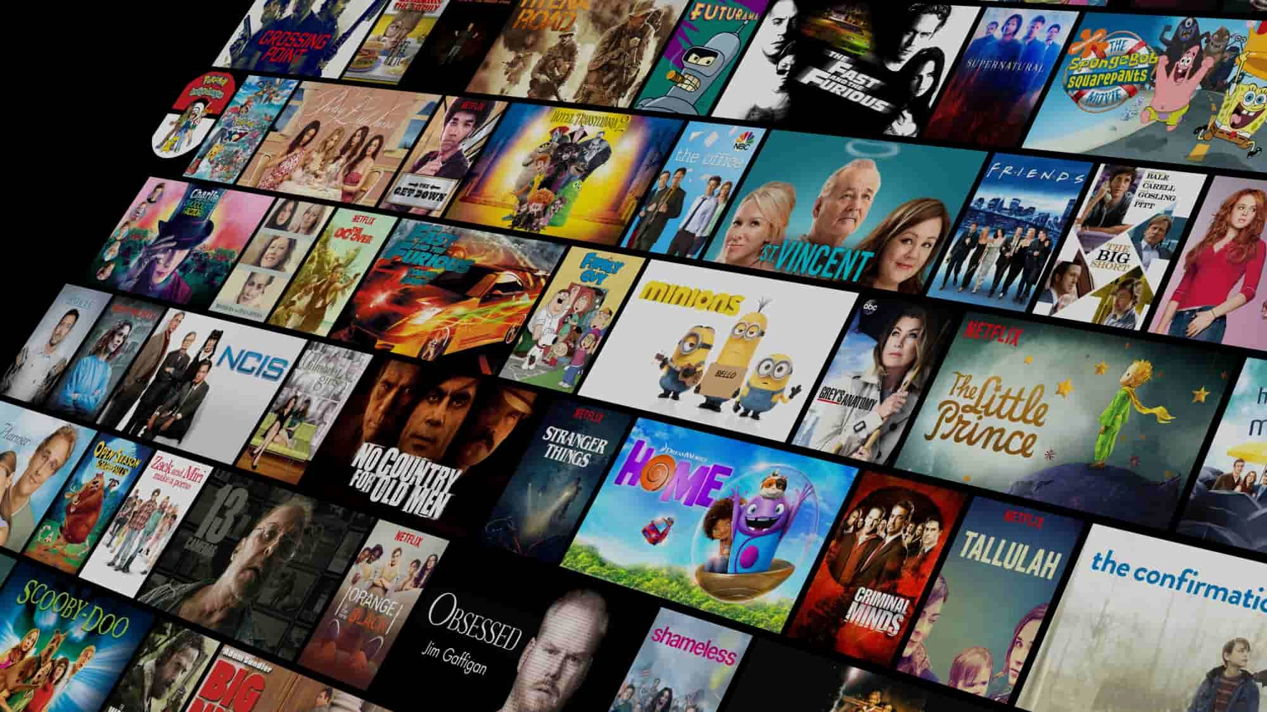

Recommendation System
By: Kaley Wong

Slide 2

Home TV Shows Movies Recently Added My List
Problem Statement and Context
Problem Statement:
Users have trouble finding shows and movies they like, causing dissatisfaction and churn
Context:
There are too many content choices on Netflix
We need a good recommendation system to help users
OVERVIEW EPISODES TRAILERS & MORE MORE LIKE THIS DETAILS

Slide 3
Home TV Shows Movies Recently Added My List
Success Metrics, Stakeholders, and Constraints
Success Metrics:
Increase satisfaction and engagement
Improve retention rates
Stakeholders:
Netflix users
Netflix content and engineering teams
Constraints:
Large and diverse dataset
OVERVIEW EPISODES TRAILERS & MORE MORE LIKE THIS DETAILS

Slide 4
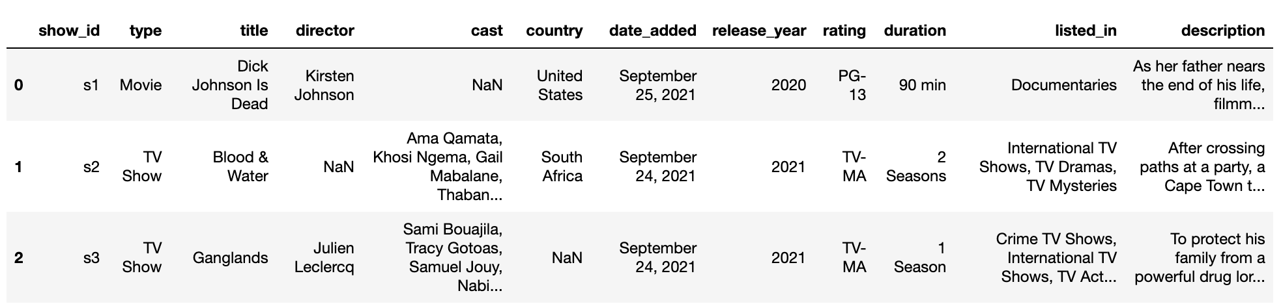
Home TV Shows Movies Recently Added My List
Data Science Problem and Dataset Description
Data Science Problem:
Create a content-based recommendation system
Dataset Description:
Data includes titles, directors, cast, genres, director, release year, rating, duration and description
size: 6,131 titles (movies and TV Shows)
Various text-based and categorical features

Slide 5
Home TV Shows Movies Recently Added My List
Data Wrangling Steps
Steps:
Found and filled missing values
Removed stopwords and special characters
Cleaned text columns for better analysis
Columns Cleaned: Directors, Cast, Country, Genres
Key Takeaways:
Ensured data quality and consistency
OVERVIEW EPISODES TRAILERS & MORE MORE LIKE THIS DETAILS

Slide 6
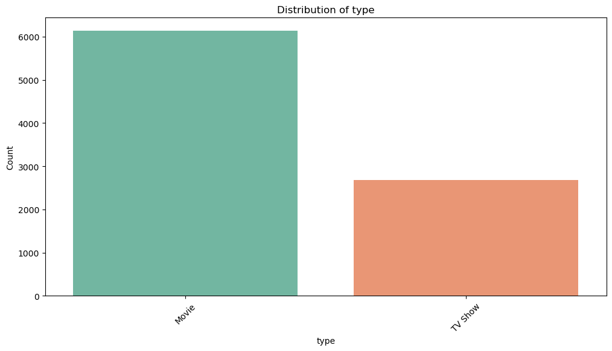
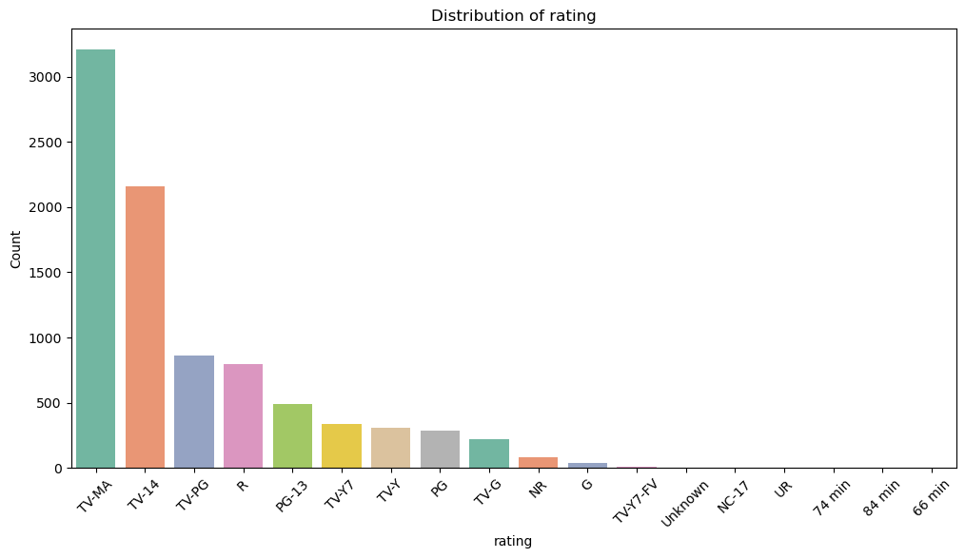
Home TV Shows Movies Recently Added My List
Exploratory Data Analysis - Content Distribution
Movies vs. TV Shows
More movies than TV Shows
User Ratings
TV-MA, TV-14, and TV-PG are common
Fewer G, NC-17, UR ratings
OVERVIEW EPISODES TRAILERS & MORE MORE LIKE THIS DETAILS

Slide 7
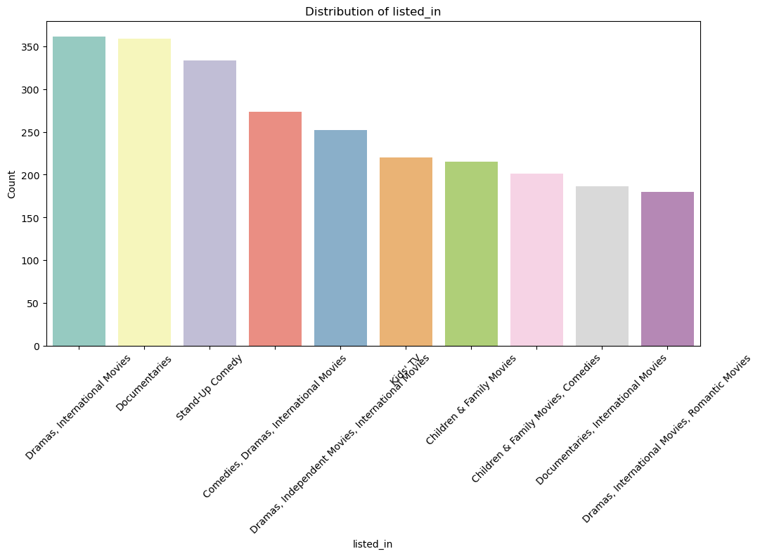
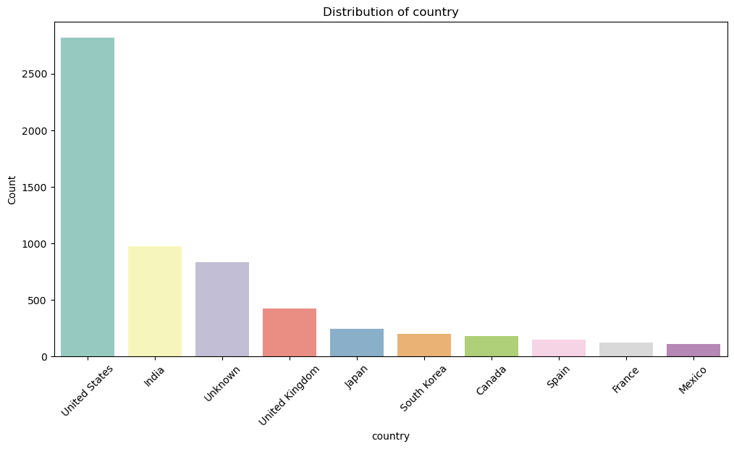
Home TV Shows Movies Recently Added My List
Exploratory Data Analysis - Geographical Distribution and Popular Genres
Leading Countries
US, India, UK, Canada
Top Genres
Drama, Comedies, Documentaries
OVERVIEW EPISODES TRAILERS & MORE MORE LIKE THIS DETAILS

Slide 8

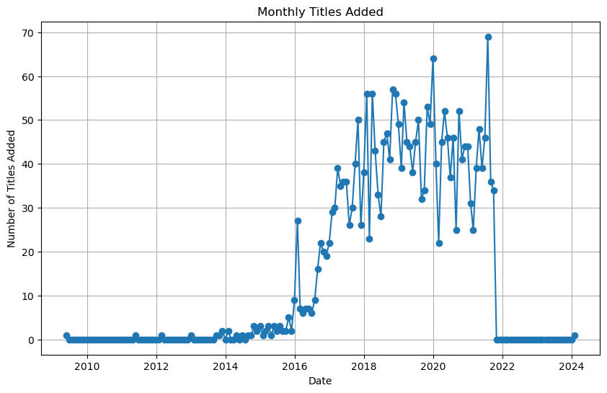
Home TV Shows Movies Recently Added My List
Exploratory Data Analysis -
Yearly Additions
2022
TV-PG
Trends:
Content library is growing
Notable Spikes:
Big additions in 2020 during the pandemic
▶ PLAY
+ MY LIST
Staring:
Genre:
This Show is:
OVERVIEW EPISODES TRAILERS & MORE MORE LIKE THIS DETAILS

Slide 9
Home TV Shows Movies Recently Added My List
Modeling Approach
Chosen Method:
Content-based filtering
Reasoning:
Focus on content similarities
Use rich metadata for recommendations
OVERVIEW EPISODES TRAILERS & MORE MORE LIKE THIS DETAILS

Slide 10
Home TV Shows Movies Recently Added My List
Data Preprocessing for Modeling
Preprocessing Steps:
Removed stopwords and special characters
Binary tokenization using CountVectorizer
Feature Engineering:
Created binary matrices for directors, cast, countries and genres
OVERVIEW EPISODES TRAILERS & MORE MORE LIKE THIS DETAILS

Slide 11
Home TV Shows Movies Recently Added My List
Analysis Results
Similarity Calculation:
Used cosine similarity matrix
Recommendations:
Top 5 relevant titles based on content similarities
OVERVIEW EPISODES TRAILERS & MORE MORE LIKE THIS DETAILS

Slide 12
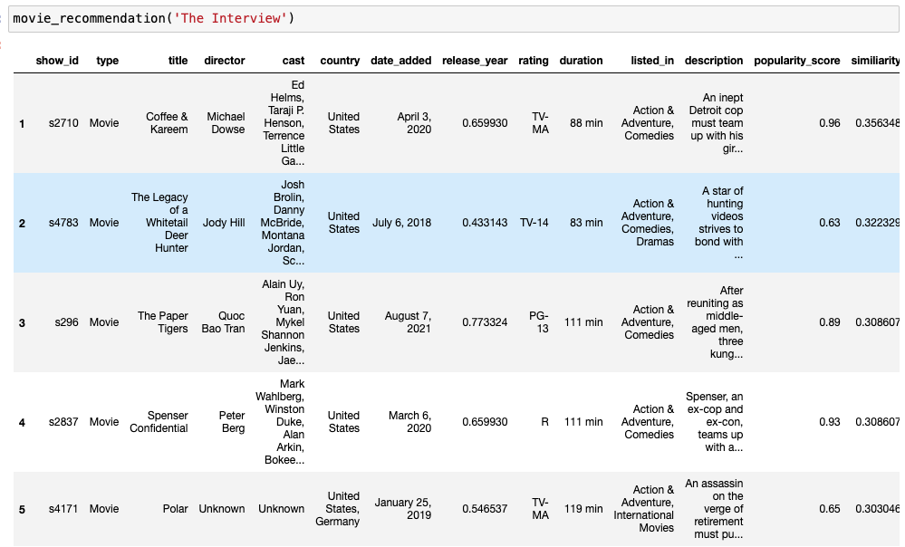
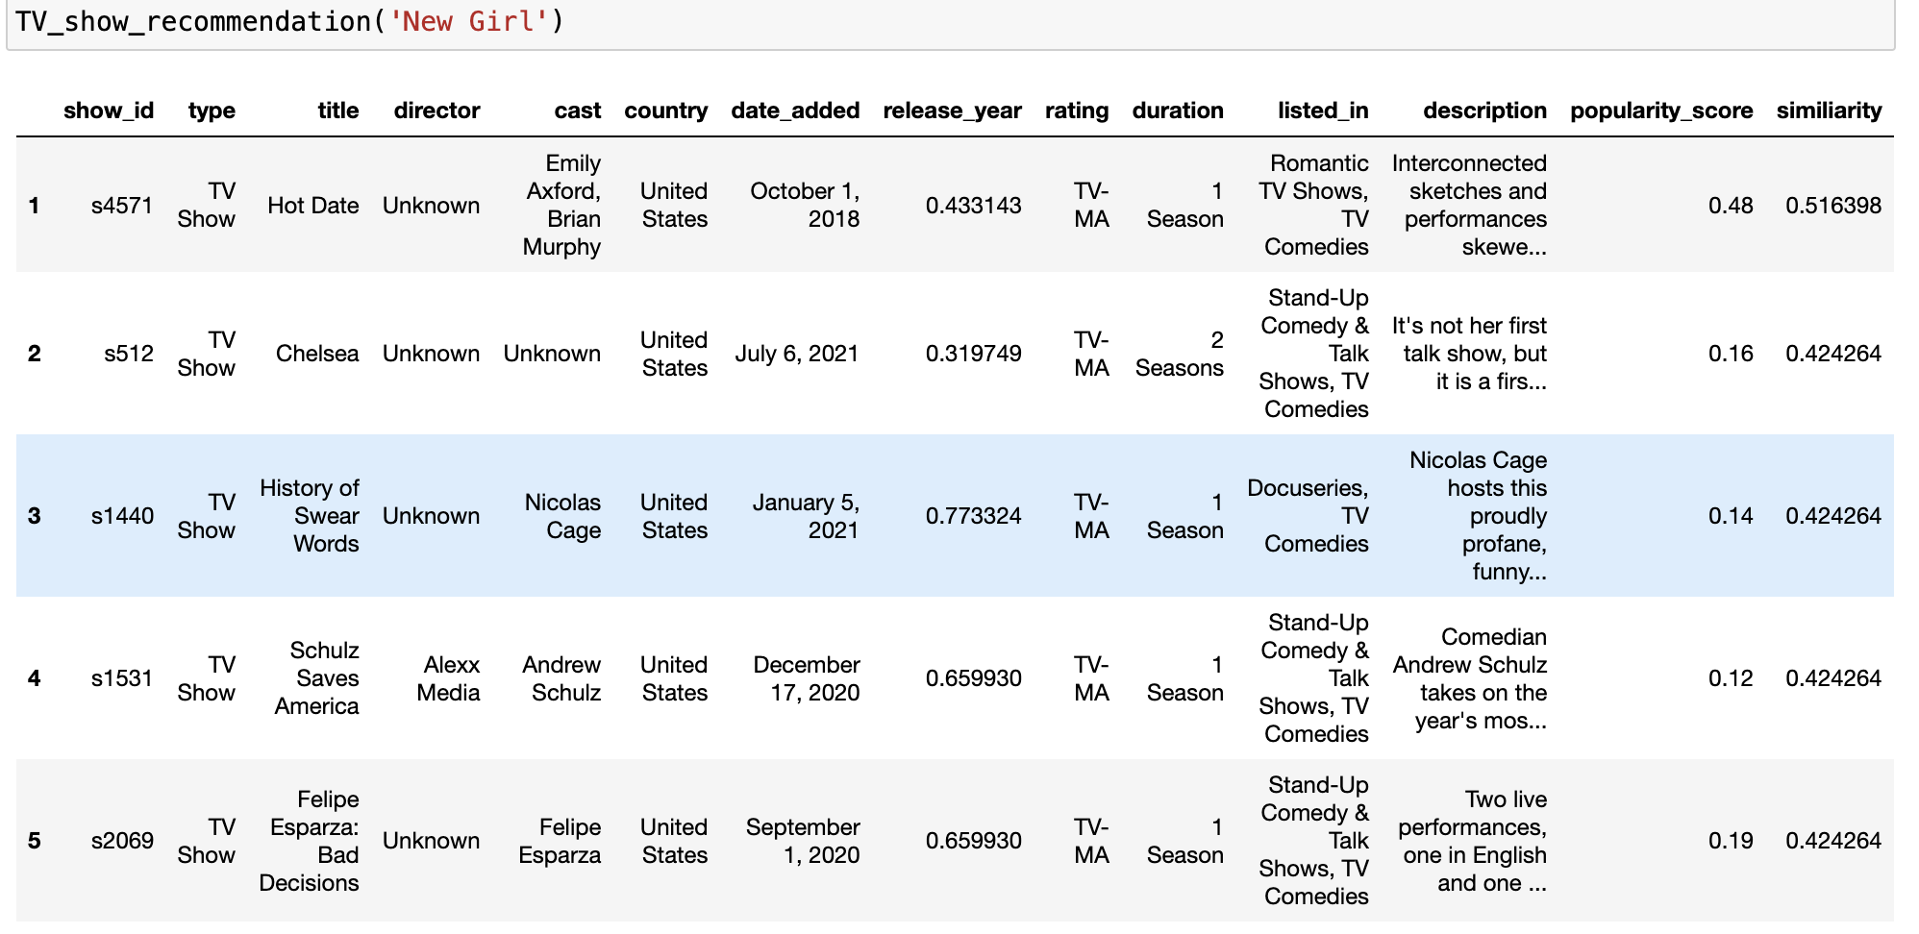
Home TV Shows Movies Recently Added My List
Analysis Results
Season 1
TV Show Recommendation Result with input “New Girl”
Movie Recommendation Result with input “The Interview”
OVERVIEW EPISODES TRAILERS & MORE MORE LIKE THIS DETAILS

Slide 13
Home TV Shows Movies Recently Added My List
Recommendations for Netflix
Enhance User Experience:
Provide personalized content suggestions
Increase Engagement:
Recommend relevant titles based on metadata
Improve Retention:
Tailor viewing experiences to user preference
OVERVIEW EPISODES TRAILERS & MORE MORE LIKE THIS DETAILS

Slide 14
Home TV Shows Movies Recently Added My List
Practical Considerations and Future Work
Suggestions for Improvement:
Add user viewer history for hybrid recommendations
Future Work:
Explore collaborative filtering
Continuously update the dataset for real-time recommendations
OVERVIEW EPISODES TRAILERS & MORE MORE LIKE THIS DETAILS

